Slide 1
vídeo

Slide 2
FROM
THE
BENCH
INDEX
The Company
Products
Process
Marketing
Technology
Human Resources
Legal
Strategy
Financial Plan
APPENDICES
Notes:
ok

Slide 3
FROM
THE
BENCH
INDEX
The Company
Products
Process
Marketing
Technology
Human Resources
Legal
Strategy
Financial Plan
APPENDICES
Notes:
ok

Slide 4
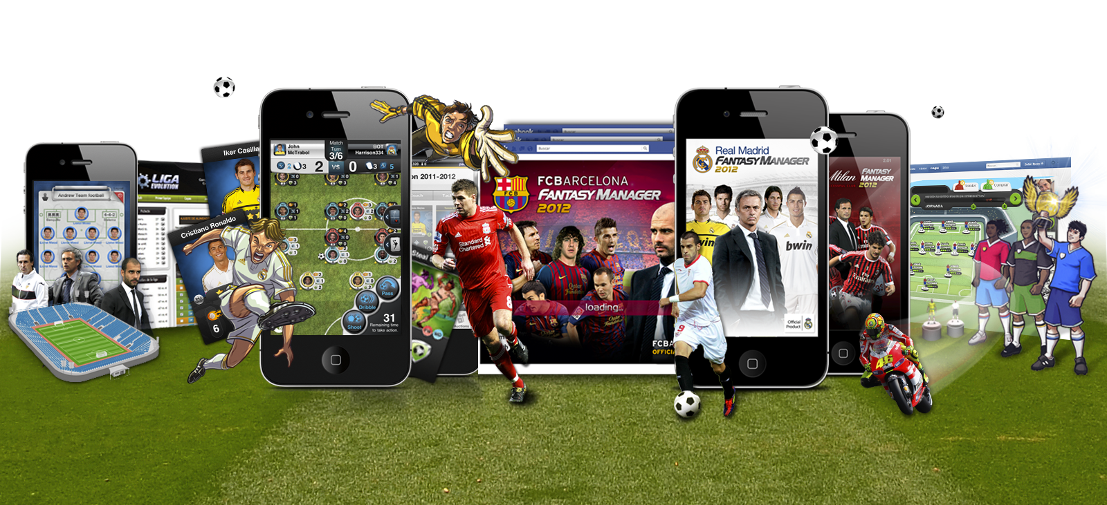
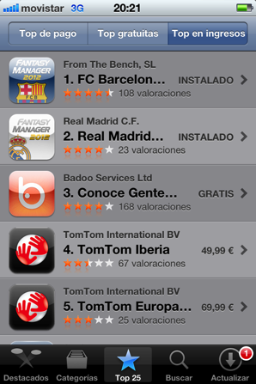
1. THE
COMPANY
FROM THE BENCH
Founded in 2008, FROM THE BENCH is a Spanish producer, manager and distributor of sport, social and mobile games in a cross-platform environment.
In FROM THE BENCH we are working very hard in order to be the world leader in social, mobile and sports digital entertainment.
Key Messages
Near 6M downloads in 5 years
Leader in mobile soccer games
Notes:
OK

Slide 5


1. THE
COMPANY
1.1.- FROM THE BENCH
Consolidation and evolution
Chinese Market
Brasilian Market
+20 Games in our Fantasy Manager Franchise
New products:
Stars Cup
Developing the Franchises
9 Multiplatform games : iPhone + Android + Facebook + Tuenti + Web
Business Angels
The Greatest Hit
Real Madrid
Fantasy Manager
New iPhone platform implementation
Sport Market Penetration
5 games: 2 motor, 2 football, 1 basket
Startup From The Bench
The beginning
Nuestraliga.com
Our first game released on Web
From The Bench foundation
2003
4 employees
16 users
2008
6 employees
300.000 users
2009
8 employees
400.000 users
2010
12 employees
1.000.000 users
100.000 fans
2011
25 employees
2.500.000 users
1.000.000 fans
2012
35 employees
+5.000.000 users
+1.500.000 fans

Slide 6
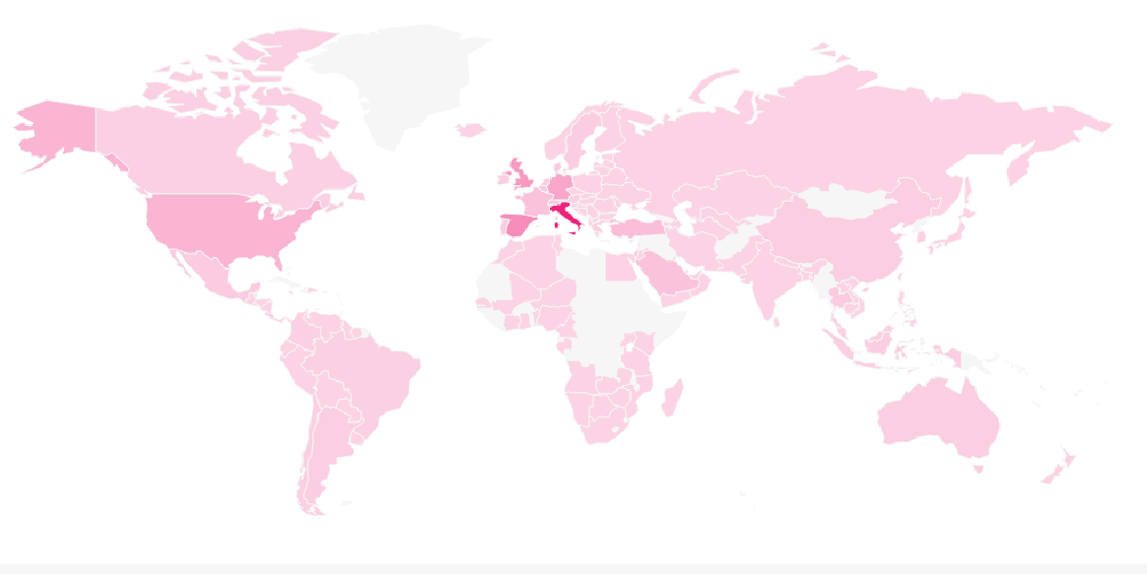

1. THE
COMPANY
1.2. - FROM THE BENCH IN A SNAPSHOT
Employees: more than 40 professionals.
Producing social and mobile games since 2003
Number of users: Near 6 million
Game’s franchises LIVE: 3
Operating / presence worldwide
Revenue share model
WORLWIDE USERS
Notes:
ok

Slide 7
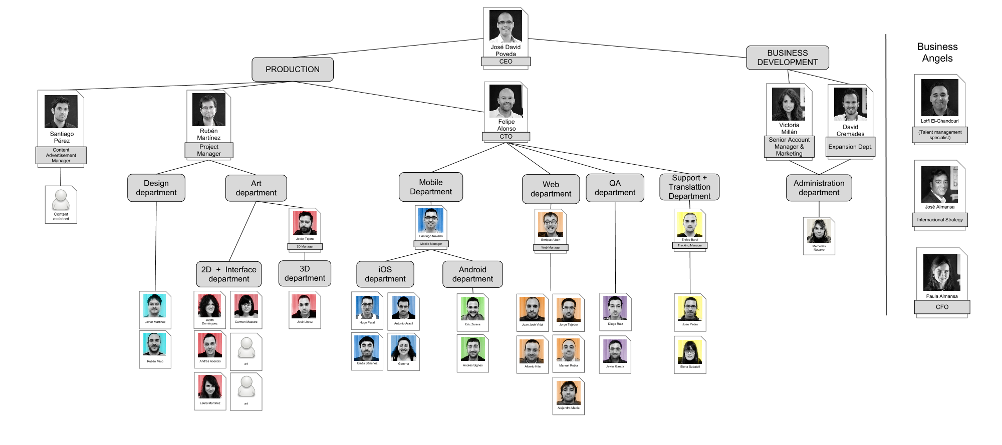
1. THE
COMPANY
1.3. - The Organization
Notes:
ok

Slide 8
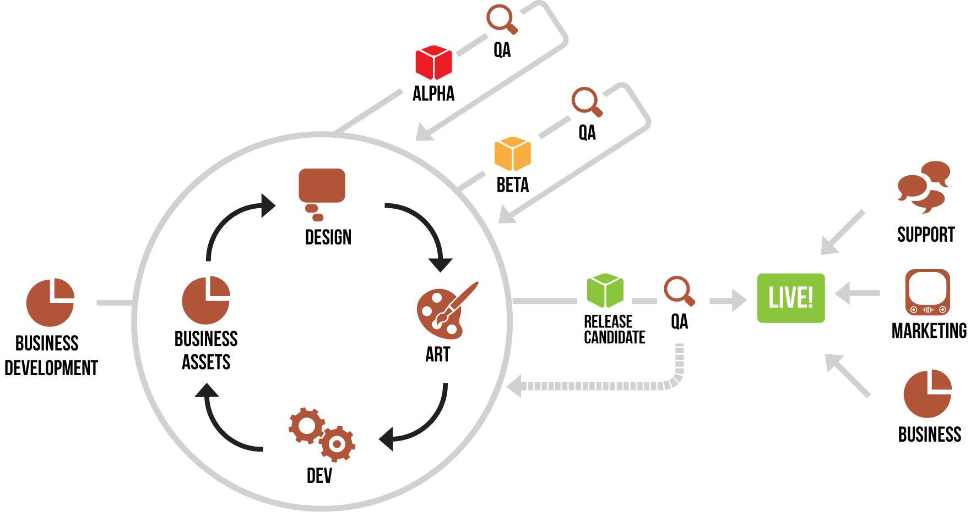
1. THE
COMPANY
1.4.- METHODOLOGY
Key Messages
Very dynamic
Fully integrated departments
Agile methodology
Elapsed time to break the first version of a product into the market: 6-8 months with a team of 5 professionals.
Follow-up version in a very shorter timetable.
Notes:
ok

Slide 9
2. PRODUCTS
INDEX
The Company
Products
Process
Marketing
Technology
Human Resources
Legal
Strategy
Financial Plan
APPENDICES
Notes:
OK

Slide 10




2. PRODUCTS
2.- GAMES
IN THE MARKET
3 Currently LIVE franchises
After Real Madrid CF and AC Milan success in 2010, many top football teams around the world contacted with From The Bench
We currently have 14 Fantasy Manager teams LIVE, 6 under development and other 12 in the pipeline
After the Fantasy Manager success, Starscup was launched in 2012 as a pilot experience with Real Madrid CF
Notes:
ok

Slide 11

2. PRODUCTS
2.1.- LIGA EVOLUTION
THE BEGINNING
Spanish Market
TOTAL USERS 300K
MAU 18K
DAU 5.5K
TOTAL REVENUE €80K
PLATFORMS WEB
ARPU €1.21
Key Messages
Launched in 2003
High engagement
Very high ARPU
Easily customized to other leagues and championships
* Data got from August 2011 to April 2012
Notes:
ok

Slide 12
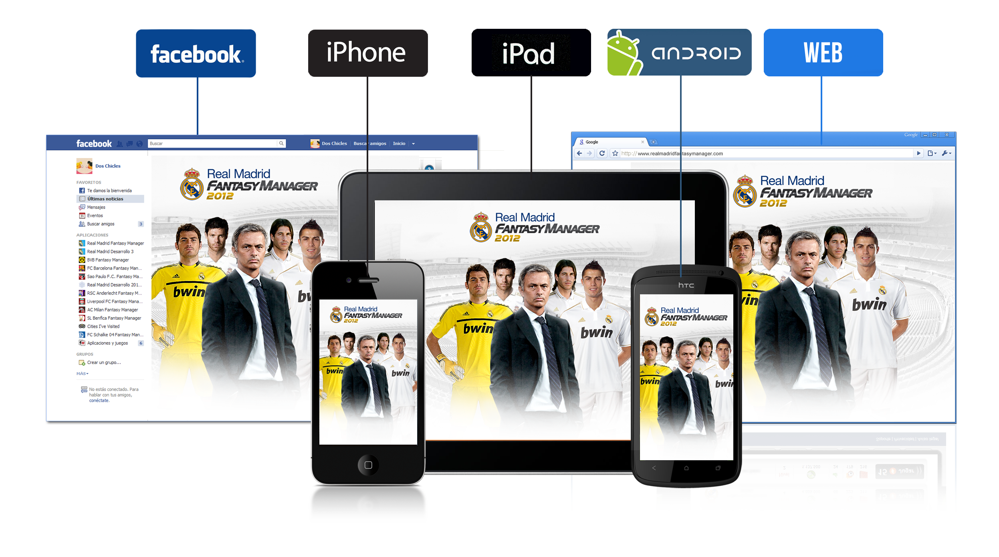
2. PRODUCTS
2.2.- FANTASY MANAGER
THE GREATEST HIT
On Fantasy Manager game, users can manage the team of their dreams from several points of view: sport, financial, marketing, facilities…
Key Messages
TOTAL DOWNLOADS 5.6M
MAU 1M
DAU 130K
TOTAL REVENUE € 2M
PLATFORMS FACEBOOK, iOS, ANDROID
The Best Fantasy Games and the Best Manager Games
Top15 Teams
Your favourite Player in your favourite Team
* Data got 1st, May 2012

Slide 13


2. PRODUCTS
2.2.- FANTASY MANAGER
THE GREATEST HIT

Slide 14
2. PRODUCTS
2.2.1.- FANTASY MANAGER
TOP GROSSING
Since October, 17th 2011
FC Barcelona and Real Madrid CF have steadily kept their Fantasy Manager games at the top list of the Spanish App Store in terms of revenues

Slide 15
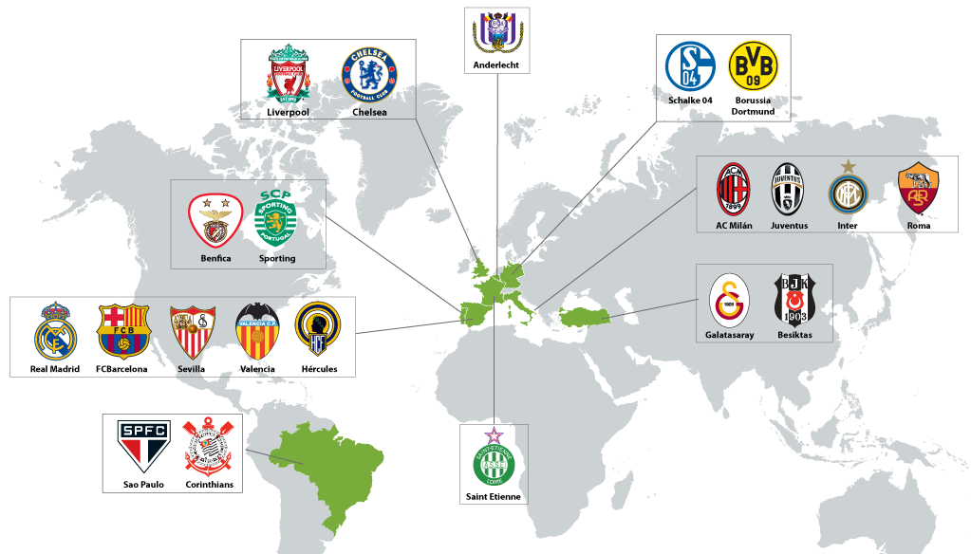
2. PRODUCTS
2.2.2.- CURRENT GAMES
PRESENCE IN 8 COUNTRIES
Notes:
REVISAR SI FALTAN PAISES

Slide 16
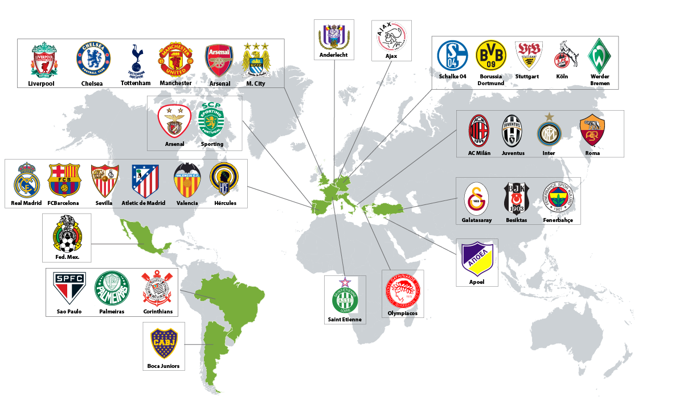

2. PRODUCTS
2.2.3.- UPCOMING GAMES
PIPELINE

Slide 17


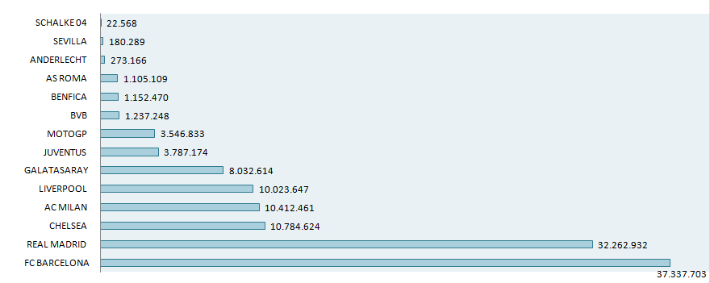

2. PRODUCTS
2.2.4.- MILLION OF FANS
In social media
Total Potential Users from Social Media´s Clubs
2011-2012 season
+ 130 MILLION
2012-2013 season
+ 210 MILLION!!

Slide 18
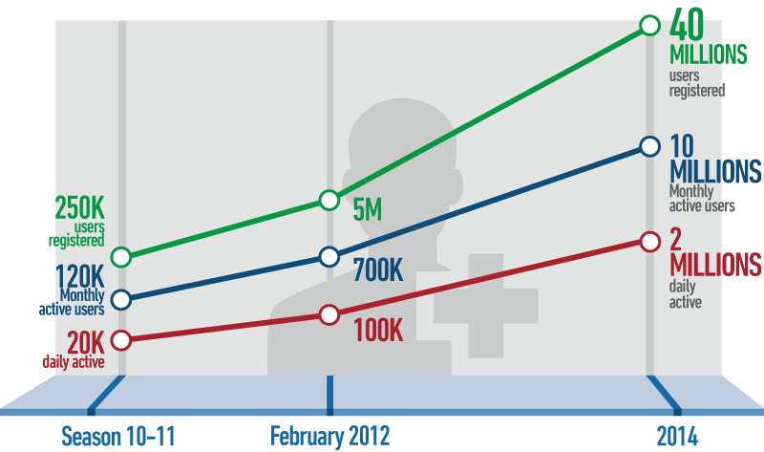
2. PRODUCTS
2.2.5.- STATS - GROWTH

Slide 19
2. PRODUCTS
2.2.6.- STATS - GROSS
2.3M/€
(End Season Forecast)
300K/€
Gross Revenue
1.6M/€
(to date)
Season 2010-2011
(Jul10 – Jun11)
Season2011-2012
(Jul11 – Jun12)
Notes:
ok

Slide 20
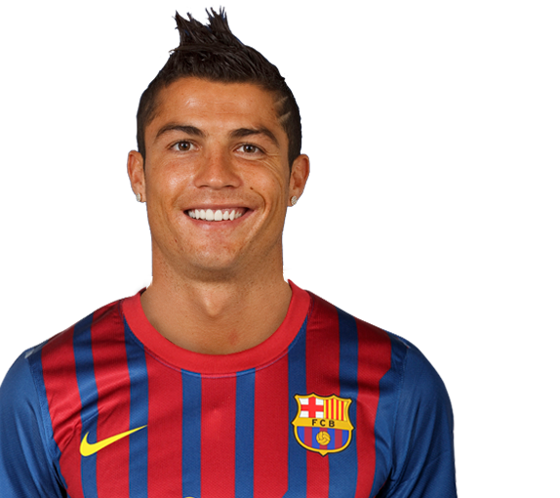
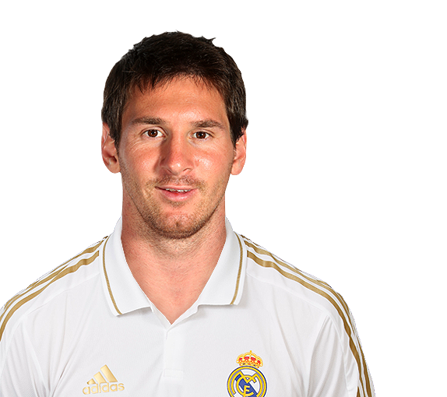
2. PRODUCTS
2.2.7.- KEY SUCCESS FACTORS
Production capacity: one week from materials reception to the upload to Apple
Full customization: tailor made to satisfy each Club’s requests
Shared licenses: possibility to use players’ licenses, as well as logos, stadiums…and possibility of mixed challenges across different games
Example: Real Madrid team could include Leo Messi to challenge any other team playing the Barcelona game
Notes:
ok

Slide 21




2. PRODUCTS
2.3.- STARSCUP
THE FUTURE
NEW PRODUCT!
TOTAL DOWNLOADS 40K
MAU 21K
DAU 1.6K
TOTAL REVENUE €7K
PLATFORMS iOS
COMING SOON
June 2012

Slide 22
FROM
THE
BENCH
INDEX
The Company
Products
Process
Marketing
Technology
Human Resources
Legal
Strategy
Financial Plan
APPENDICES
Notes:
ok

Slide 23












3. PROCESS
PROCESS
CEO /
BUSINESS DEVELOPMENT
ACCOUNT
MANAGER
PROJECT
MANAGER
CEO
CEO
Contact with the Club
Agreement terms negotiation
Reception of Club’s material for the game
Game customization
Legal contract amendment and signature
CTO
Marketing
Support
Game Setup
Apple revision and approval
Release
Business
Notes:
ok

Slide 24
FROM
THE
BENCH
INDEX
The Company
Products
Process
Marketing
Technology
Human Resources
Legal
Strategy
Financial Plan
APPENDICES
Notes:
ok

Slide 25
4. MARKETING
MARKETING STRATEGY
PRESENT
CORPORATE
MARKETING
(Club’s Advertisement)
PRODUCT MARKETING
(in-game)
COMMUNICATION
(PR & users)
Notes:
ok

Slide 26
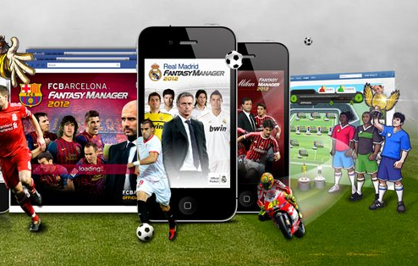

4.
MARKETING
4.1.- COMMUNICATION
4.1.1.- PR AGENCY
PR AGENCY
COMMUNICATION
(PR & users)
Branding
HOW?
394 National + 87 International
MEDIA
Product
Press Releases
Article
Interviews
Researches
Notes:
ok

Slide 27
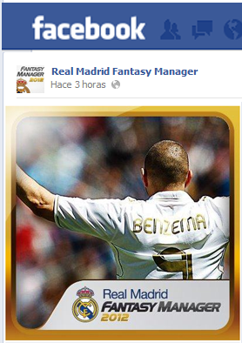




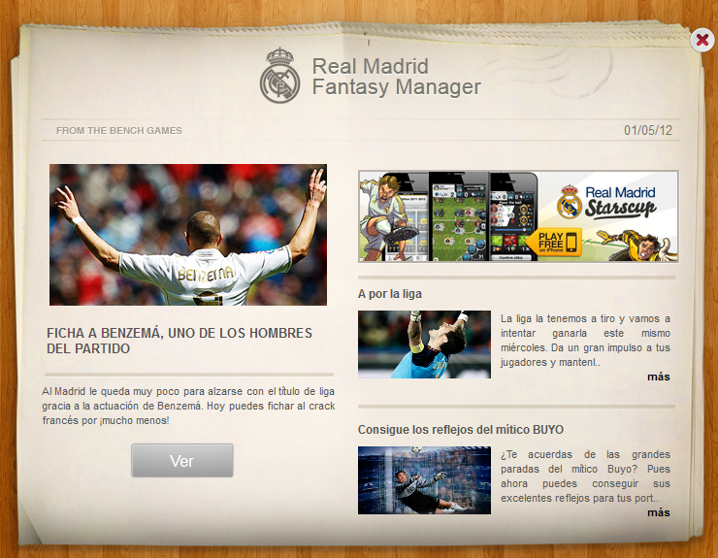
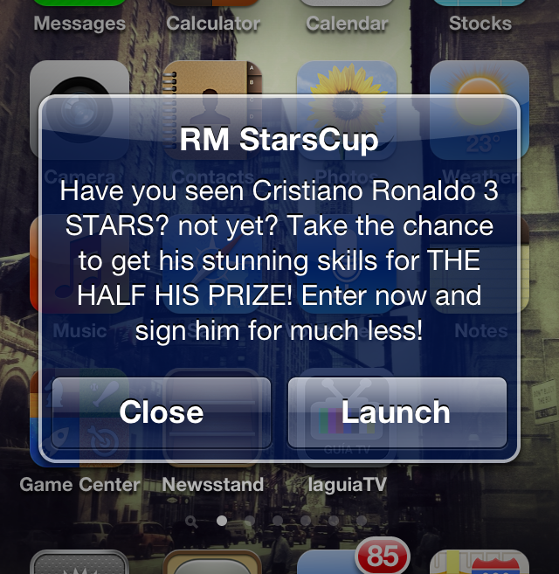
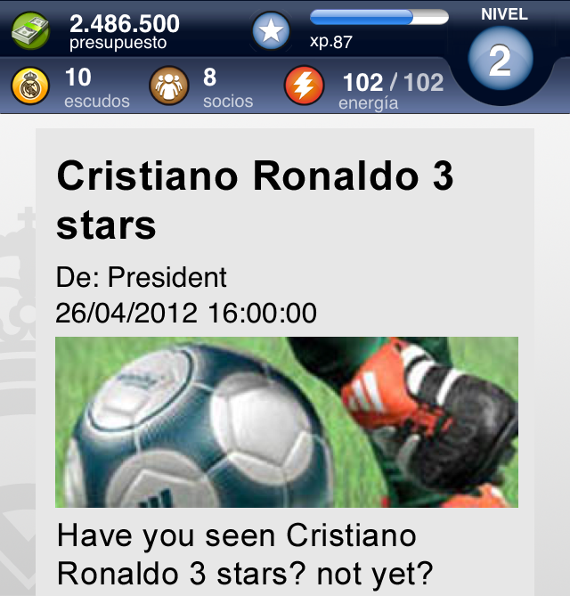


4. MARKETING
4.1.2.- COMMUNICATION WITH USERS
OUT-GAME
COMMUNICATION
(PR & users)
Social Media (Games & Club)
IN-GAME
Notification
Pushes
In-box
messages
Support
In-game Newspaper
Notes:
ok

Slide 28

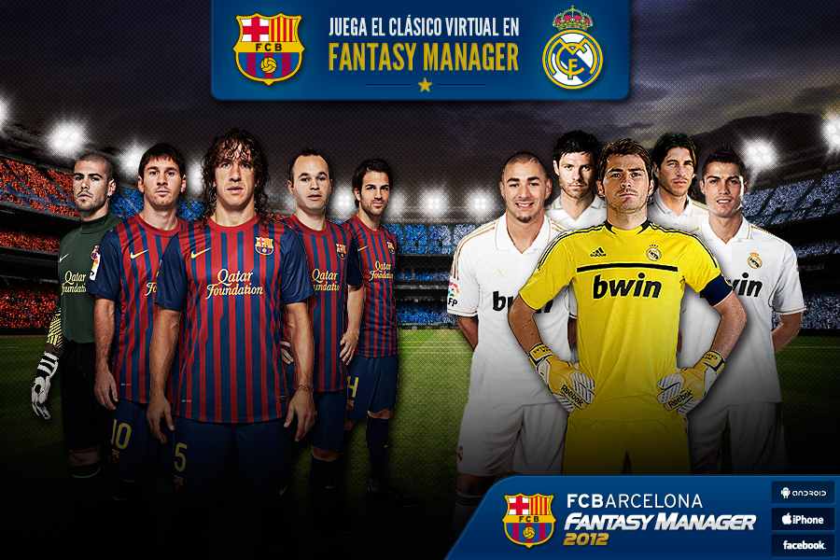
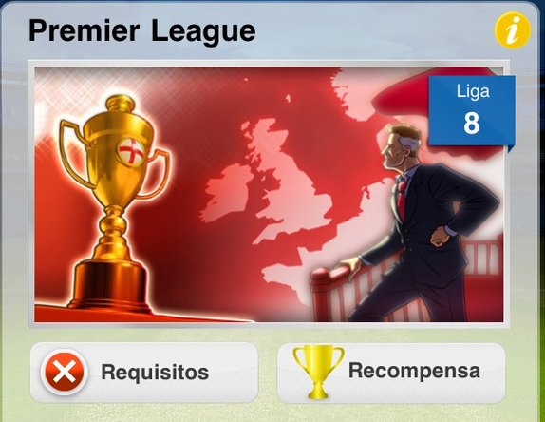
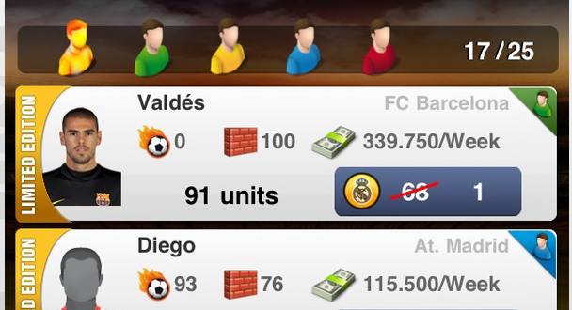
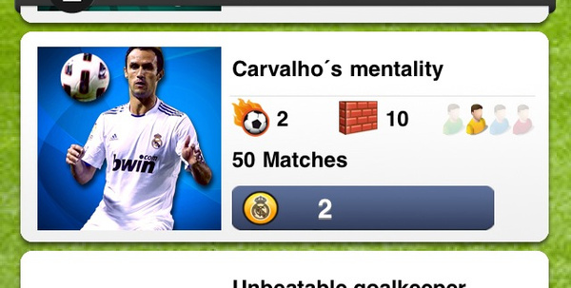

4. MARKETING
4.2.- PRODUCT MARKETING
THE GAME IS ALIVE
Examples of In-game Actions
Tournaments against other clubs
Virtual Derby
Virtual Classic
PRODUCT MARKETING
(in-game)
Limited Editions
Virtual Goods
Player of the day
Notes:
ok

Slide 29
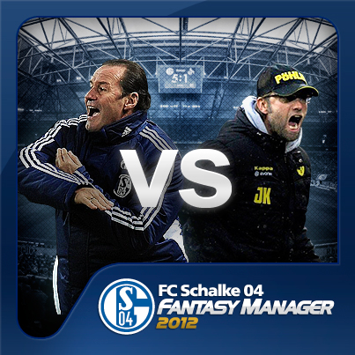
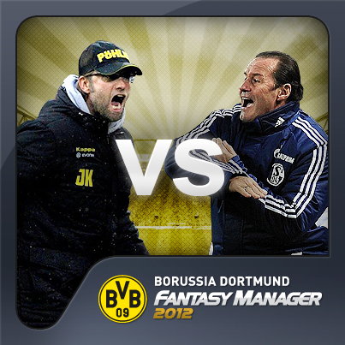
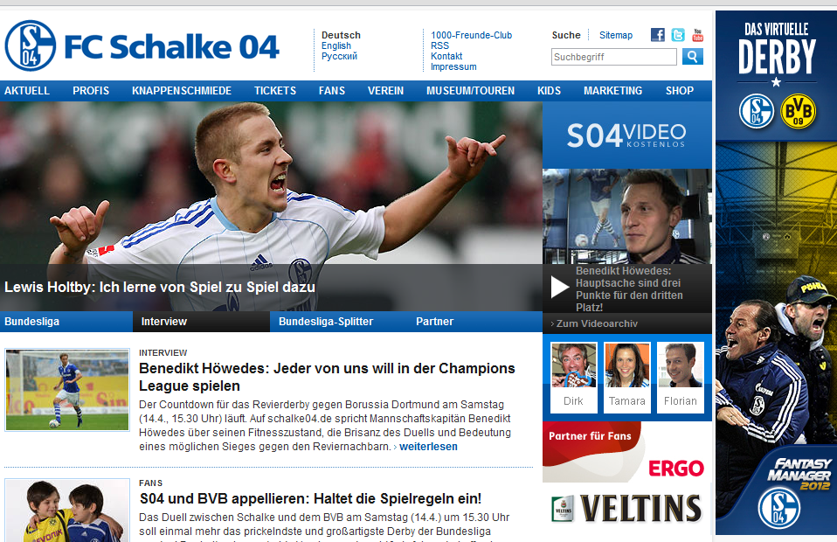
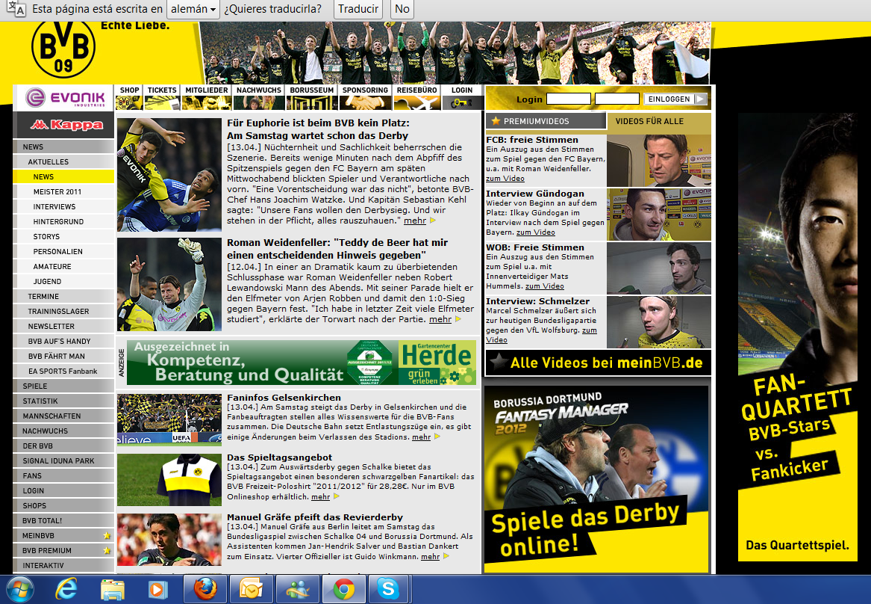
4. MARKETING
4.2.1.- PRODUCT MARKETING
CASE STUDY
VIRTUAL DERBI
Clubs make promotions through their websites and Social Media channels
Coordination between the Clubs (bidirectional communication)
PRODUCT MARKETING
(in-game)
4 Days competition
20.000 users competed
1.3 MILLION IMPACTS!!
Notes:
ok

Slide 30


4. MARKETING
4.3.- CORPORATE MARKETING
TEAMS SUPPORTS
AD MAGANZINES
+
EMALINGS
+
SOCIAL MEDIA ANNOUNCEMENTS
+
NEWSLETTERS
+
BANNERS
+
MAGAZINES
+
LED´S ON PITCH
Key Messages
FROM THE BENCH
Teams are very involved in marketing efforts through all their offical channels
+130Million
OF IMPACTS!!!
CLUB
PROMOTION ACTIONS

Slide 31

4. MARKETING
4.3.1.- AD FOCUS ON TARGET
EXAMPLE OF A VIDEO BROADCASTED DURING A MATCH
Key Messages
Million of impacts on focus target!
Example AD during a match: http://www.youtube.com/watch?v=63HOhzlSx9s
Notes:
Meter (que se vea) vídeo que hicimos para la AS Roma y que proyectaron en el campo durante un partido.

Slide 32
4. MARKETING
4.4.- MARKETING STRATEGY
NEXT STEP
Add more Metrics
Add more Research Market
Invest AD campaign
Improve countries’ adaptation
Improve marketing product
INCREASE REVENUE / ARPU
Notes:
ok

Slide 33
FROM
THE
BENCH
INDEX
The Company
Products
Process
Marketing
Technology
Human Resources
Legal
Strategy
Financial Plan
APPENDICES
Notes:
ok

Slide 34
5. TECHNOLOGY
5.1.- ARCHITECTURE
CONNECTED TO THE WORLD
Key Messages
VIEW
Web (HTML5 + CSS)
Android
iOS
MODEL
Common for all the platforms
PHP
Better control and performance
Homogenize the controller’s code through options’ evaluation.
BBDD MySQL
+ Memcached
MongoDB for BigData
CONTROLLER
WEB (PHP)
ANDROID (JAVA)
iOS (Objetive C)
(NATIVE CODE –
NO FRAMEWORK)

Slide 35
5. TECHNOLOGY
5.2.- PLATFORMS
OUR SYSTEMS
Expensive (flexible option)
Useful for the first release in order to know the infrastructure requirements
CLOUD
HOSTING
Expensive
Low Flexibility
Cheap + Full Control
Low price of connectivity, acquisition cost recovery estimated in 12 months
HOUSING
Notes:
Revisar título

Slide 36
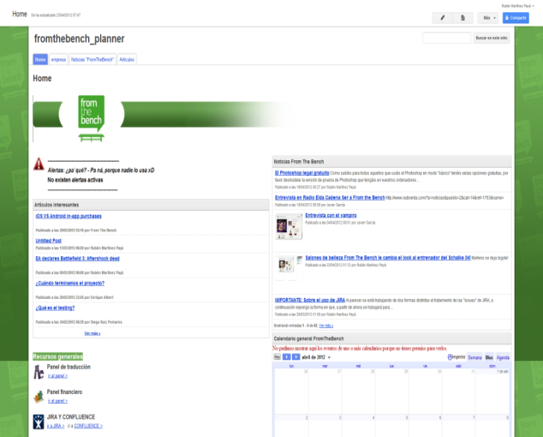





5. TECHNOLOGY
5.3.- TOOLS MANAGEMENT
MANAGEMENT
intranet
email
skype
Google Docs
JIRA
Perforce
COMMUNICATION
Best practices
Process
GDDs
Notes:
Revisar título

Slide 37
FROM
THE
BENCH
INDEX
The Company
Products
Clients – Clubs
Technology
Marketing
Human Resources
Legal
Strategy
Financial Plan
APPENDICES
Notes:
ok

Slide 38




6. HUMAN RESOURCES
6.1.- VALUES
THE BEST TEAM IS IN-HOUSE
Chiefs who are not chiefs
The chief is here to help you, not to reproach you
Process YES,
dictaturship NO
Here we listen to everyone and it’s not just a way of speaking
We don’t seek guilt but responsibility
We let everybody to be responsible for his job.
Funny is better than boring
A relaxed and positive environment makes the knowledge flow

Slide 39

6. HUMAN RESOURCES
6.2.- HH. RR. STRATEGY
THE BEST TEAM IS IN-HOUSE
Positive work environment (Low % Turn Over)
Horizontal working method
Promote team-working activities
Engagament with the company (voluntary overtime)
Internal Customer
Internal Process
Recruitment process (Video Games´ Master, Engineer IT Degree in Alicante)
Qualify employees
4 Perspectives
Status / level / salary
Shareholder value
Internal promotion
Financial
Learning
Free English classes
Training courses

Slide 40







6. HUMAN RESOURCES
Database consultancy (MySQL)
Translators and Public Relations
Community Managers
Multilingual: English, Italian, Portuguese, German,
Spanish, French
25 – 35 years old
3 Employees
6.3.- TEAM PROFILE
WE HAVE TALENT
Financial Degree
Management Degree,
30 – 40 years old
6 Employees
Art Design Degree 2D
Art Design Degree 3D
Web developers
20 – 30 years old
9 Employees
Contract policy:
3 Months
+ 9 Months
+ Permanent
Art Design Degree 2D
Game designers
25 – 35 years old
2 Employees
Tech. Engineering in System Computer
Tech. Engineering in Management Computer
Telecommunications Engineers – Telematics
Application Development
22 – 40 years old
14 Employees
Translators
Games controller
Multilingual
25 – 35 years old
2 Employees
Marketing Degree
Advertisement Degree
Communication Degree
25 – 35 years old
2 Employees
Notes:
Comercial y Business los unificaría. Corregir palabra Business con una “n”
Añadir perfil profesional/estudios de los que falten

Slide 41
FROM
THE
BENCH
INDEX
The Company
Products
Clients – Clubs
Technology
Marketing
Human Resources
Legal
Financial Plan
APPENDICES
Notes:
ok

Slide 42
7. LEGAL
7.- LEGAL SITUATION
From The Bench is the owner of all the games,
getting license rights from its partners
to be used in its products.
No lawsuits issues.

Slide 43
FROM
THE
BENCH
INDEX
The Company
Products
Clients – Clubs
Technology
Marketing
Human Resources
Legal
Strategy
Financial Plan
APPENDICES
Notes:
ok

Slide 44



8. STRATEGY
8.- STRATEGY
Fantasy Manager
Increase franchised club number.
Diversify sports (basketball, NFL, etc…)
StarsCup
Increse franchised clubs
Nuestraliga:
New game design + Adapt format to other leagues
Develope new games:
Be a Legend
Start Players
Empire

Slide 45








8. STRATEGY
8.1.- PIPELINE
NEW
STAR PLAYER
BE A LEGEND
EMPIRE
TO BE CONTINUED
NEW SEASON
V1.2
V1.3
2.0x
V2.3
V3.0x
2012 | 2013
JUNE
SEPTEMBER
DECEMBER
JAN
MAR
JUN
SEP
DEC

Slide 46
FROM
THE
BENCH
INDEX
The Company
Products
Clients – Clubs
Technology
Marketing
Human Resources
Legal
Strategy
Financial Plan
APPENDICES
Notes:
ok

Slide 47
9. FINANCIAL PLAN
9.- FINANCIALS
Financials on a stand-alone basis:
Very sound and solid financials
Very high margins even in a conservative scenario
High growth expectations with internal resources
A financial structure with no debt – inefficient from a tax and operating perspective
  Scenario 1: Organic growth with no reinvestment of excess cash
  Scenario 2: Organic growth where 60% of the profits are reinvested in expansion, either accelerated growth with expansion into new products, business areas and/or geographies or through small add-on acquisitions
SCENARIO 1
SCENARIO 2
Notes:
ok

Slide 48
9. FINANCIAL PLAN
9.1.- FINANCIALS
SUMMARY OF THE 2 SCENARIOS
Key Messages
High expected growth according to business and expansion plan
Accelerated growth under reinvestment scenario
Notes:
ok
48

Slide 49
9. FINANCIAL PLAN
9.2.- FINANCIALS
Key Messages
Extremely cash generating business with large debt capacity for expansion and faster growth
Growth in income comes only from currently existing projects
Servers cost is semi-fixed: it grows much slower than revenues
During 2011 and 2012 the personnel base has grown significantly. Personnel is the largest cost within the cost base. There is a lag period between hiring and employees becoming fully productive
A structure with barely any debt is inefficient from a financial and tax perspective. There is a huge capacity to pay interests and use debt for growth and expansion
Notes:
ok
49

Slide 50
9. FINANCIAL PLAN
9.2.- FINANCIALS – SCENARIO 2
Key Messages
Assumed that each €1 of expenses generates on average €2.5 of additional revenue
Reinvestment of profits significantly accelerates growth, even if the company remains debt-free
As an example, reinvestment of 60% of the net profit from the previous year. This amount has an impact on the level of new income generated
Assumed that 60% of profits are reinvested and the rest used for debt repayment and/or dividends
Notes:
ok
50

Slide 51
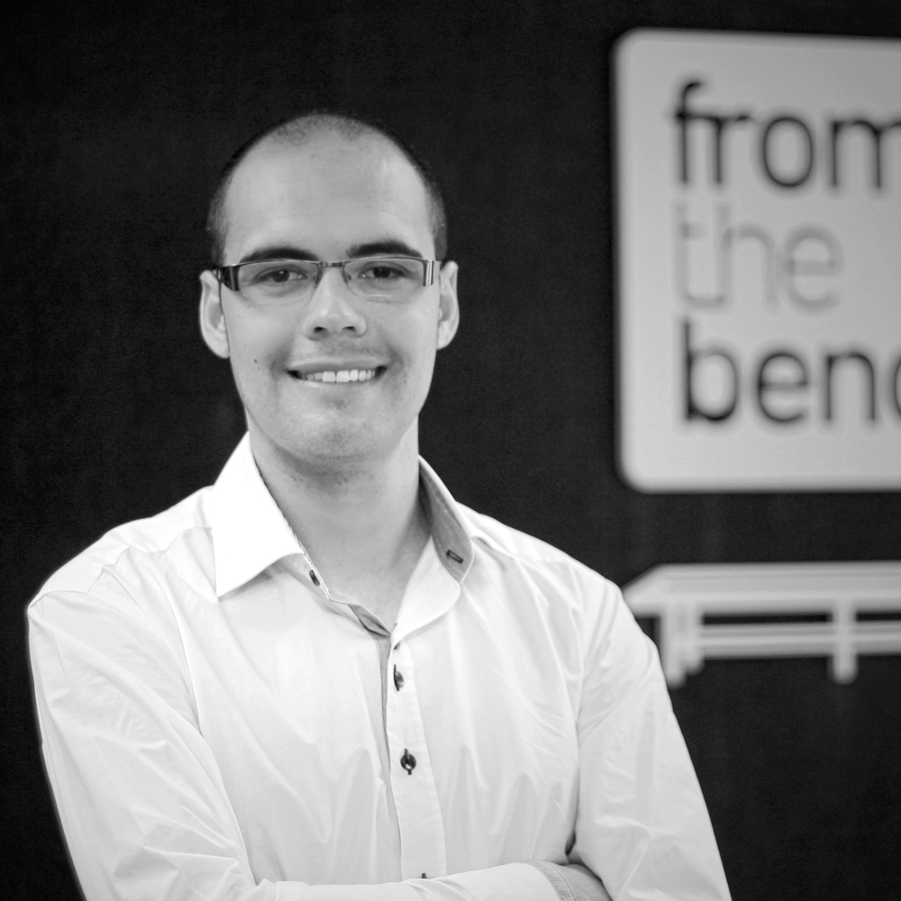
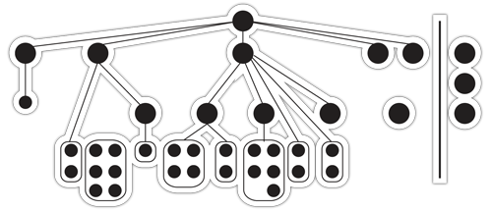
APPENDICE
MANAGEMENT
LIVING IN A DIGITAL WORLD
José David Poveda
CEO
From The Bench co-founder in 2008.
General manager with wide entrepreneurial background during more than 10 years, specialized in sport business, new media, mobile apps and videogames markets.
Academic background
Master - Information Systems Management, TIC. Polytechnic University of Valencia.
Computer Engineering, Software Engineering. University of Alicante.
Achievements
Lecturer in the Videogames Production Master in Alicante University
Speaker in entrepreneurship conferences.
Languages
English and Spanish.

Slide 52
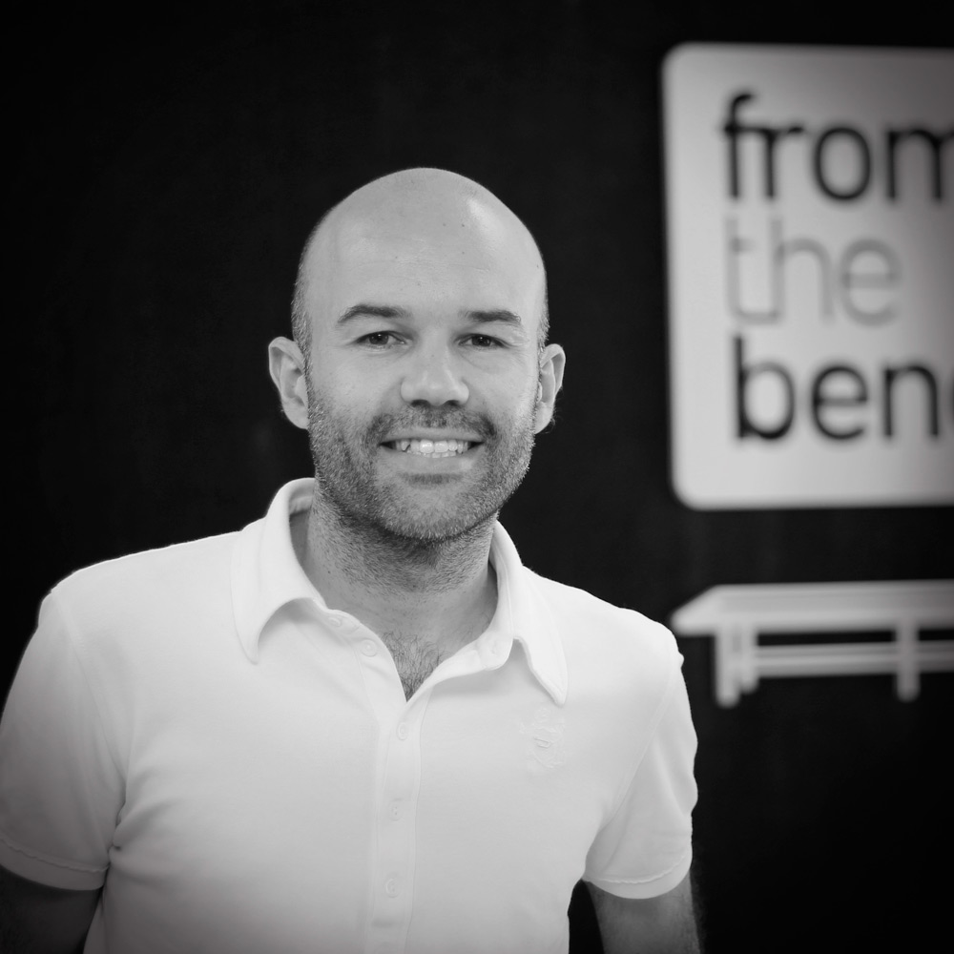
APPENDICE
MANAGEMENT
Technology visionary and Operations Manager
Felipe Alonso Simarro
CTO
From The Bench co-founder. Joined the Company in 2010.
Chief Technology with entrepreneurial vision in technology-oriented companies. More than Executive power and day-to-day management and operations of IT. Strong communication and interpersonal skills. Loves game design.
”Big thinker”, development leader team, database analyst and administrator, infrastructure architect.
Negotiates with big IT providers: housing (and hosting), connectivity and hardware.
Academic background
Specialist in Information Security . Polytechnic University of Alicante.
Computer Engineering, Software Engineering. University of Alicante.
Languages
English, French and Spanish.

Slide 53
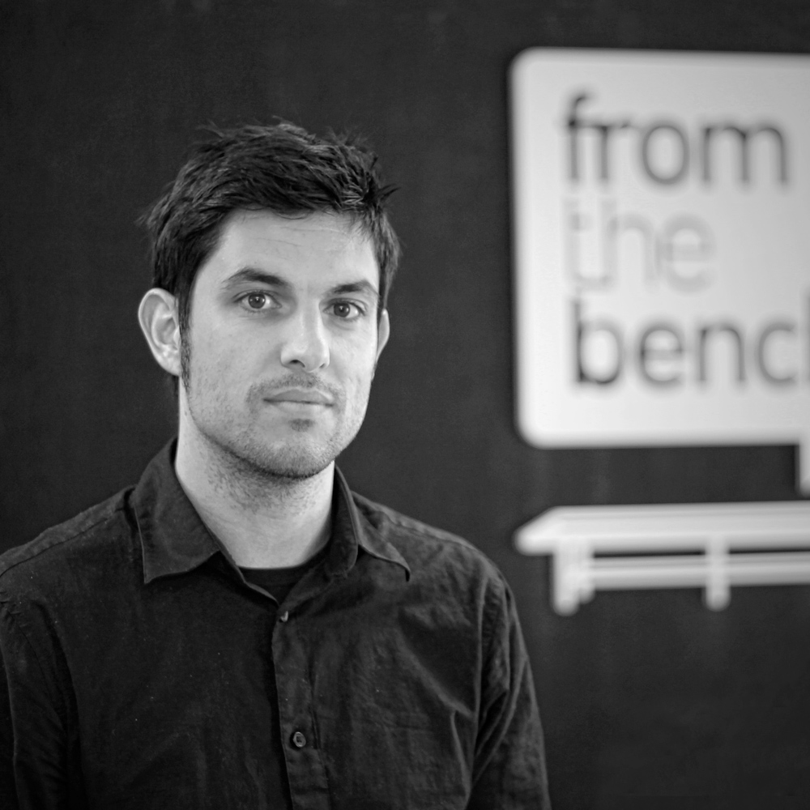
APPENDICE
MANAGEMENT
Creative Mind
Santiago Pérez Castaño
CONTENT ADVERTISEMENT MANAGER
From The Bench co-founder. Joined the Company in 2011.
More than 10 years as Creative Copywriter. Wide experience as gaming concepts developer and new media. Specialist in advertisement campaigns. Expertise on sports (major in soccer). Concept Innovation Maker.
Academic background
Postgrade – Sport Organization Management. Kernaba Institute. Madrid. Spain.
Advertising and PR Degree. CEU San Pablo University. Valencia. Spain.
Achievements
International Bronze Award. Best Campaign Direct Marketing 2011.
National Bronze Strategy Award 2011.
1st Winner -Sol de Bronze- Iberoamerican Festival. San Sebastián 2011. Spain.
Languages
English and Spanish.

Slide 54
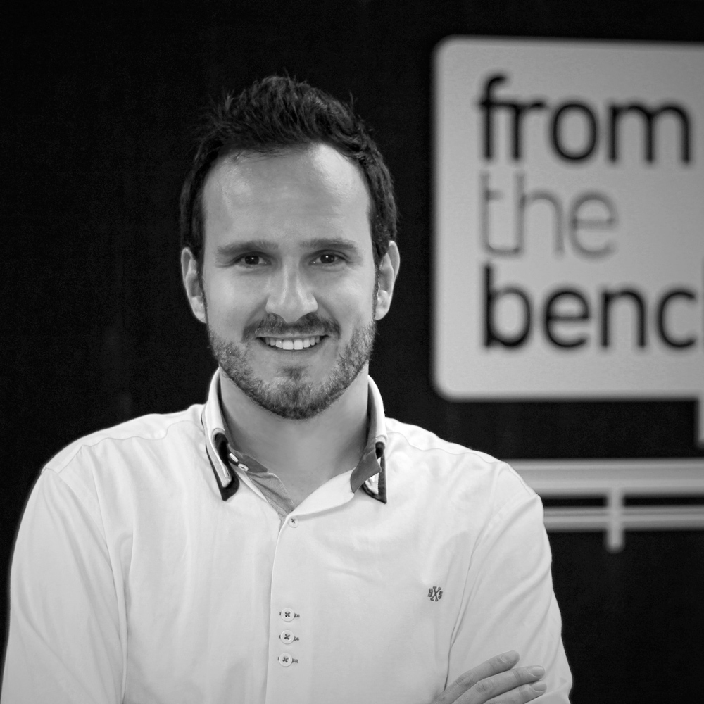
APPENDICE
MANAGEMENT
INTERNET ENTHUSIAST
David Cremades Beltrán
BUSINESS DEVELOPMENT
Founder of From the Bench. Joined the Company in 2012.
Entrepreneur with extensive experience in the Internet and new technologies. Focused on new business development. Enthusiastic about my work.
Academic background
Specialist Course Degree in Computer Security. University of Alicante.
Computer Engineering, Software Engineering. University of Alicante.
Achievements
Speaker in entrepreneurship conferences.
Languages
English and Spanish.

Slide 55
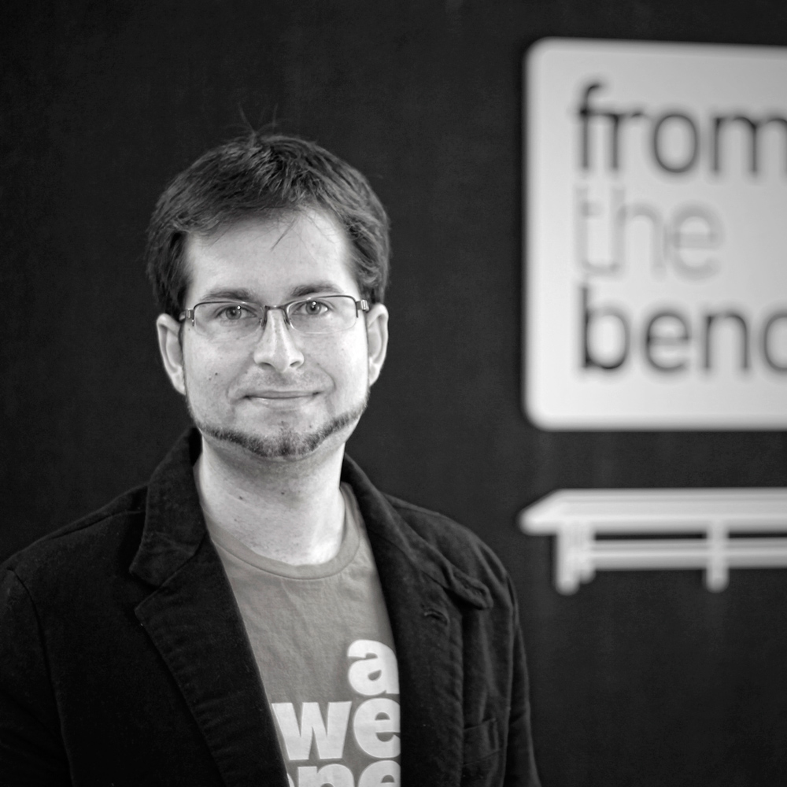
APPENDICE
MANAGEMENT
GAMES ENTHUSIAST
Rubén Martínez Payá
PROJECT MANAGER
Joined the Company in 2008.
Wide experience during more than 6 years as Art Director. Specialist in videogames development. Multiplatform developer in New Media Industry . Team leader and department-network management.
Academic background
Art Design and Illustration Degree.
Achievements
Speaker in conferences in The Art School of Alicante.
Languages
English and Spanish.

Slide 56
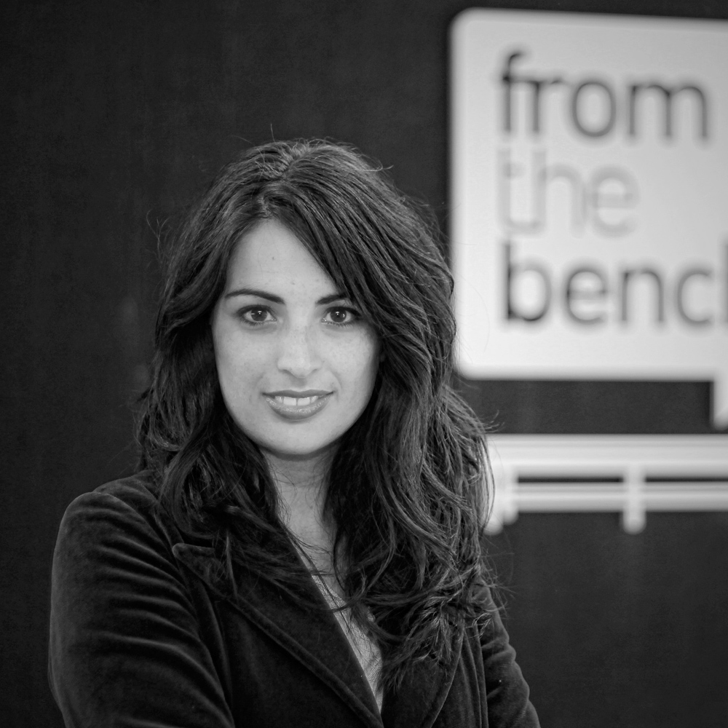
APPENDICE
MANAGEMENT
THINKING FORWARD
Victoria Millán Díaz
SENIOR ACCOUNT MANAGER & MARKETING
Joined the Company in 2012.
More than 8 years as PR and Marketing in international companies. Specialist in marketing strategy, communication, events and social media. Develop and conduct relationships with clients to ensure the efficiency level at work, the maximization of the company´s resources and ensure the satisfaction of our customers.
Academic background
Postgrade Marketing and Communication. CEF. Madrid. Spain.
Marketing Degree. John Moore University. Liverpool. England.
Achievements
Best European Communication Event Award. Milan. Italy.
Best National Decoration Event Award. Barcelona. Spain.
Languages
English, French and Spanish.

Slide 57
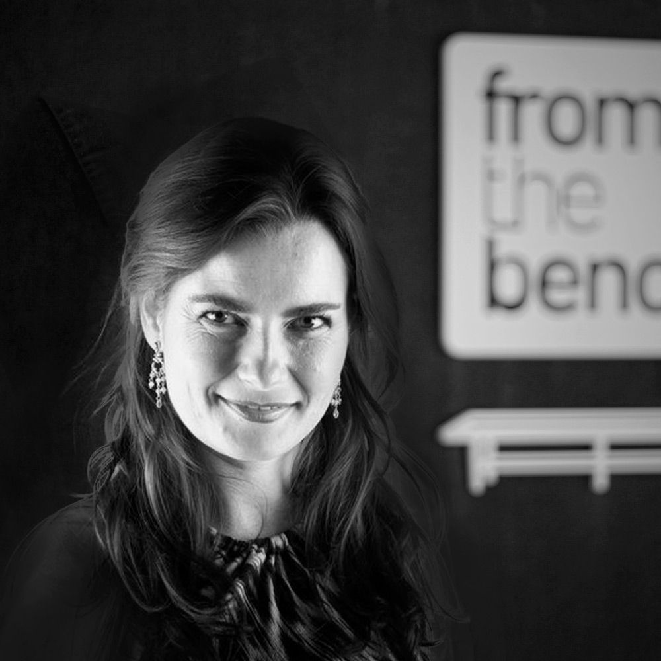
APPENDICE
MANAGEMENT
BUSINESS ANGEL
Paula Almansa
CEO & M&A
Vice President in the M&A Department of Credit Agricole CACIB, previously working for Merrill Lynch and Greenhill. Over 10 years in Investment Banking (M&A, restructuring) in Spain and London in utilities, telecoms, leisure and other sectors. Business angel: FromTheBench, West Technologies, Nisu Automotive, 21 Gramos.
Co-founder of HUB Madrid , a space for social innovators. Associate Professor in the Negotiations at Instituto de Empresa (worldwide top-ranked MBA)..
Academic background
BS in Business Administration (major in Finance) from ICADE E2 University, BA in Law and BA in Psychology from UNED University
MBA from The Wharton School of Business (UPENN), major in Entrepreneurship and Finance. Fulbright and Ramón Areces scholarships
PhD courses in in Corporate Finance at Universidad Autónoma de Madrid and Universidad Complutense de Madrid.
Languages
Spanish, English, French and Italian.

Slide 58
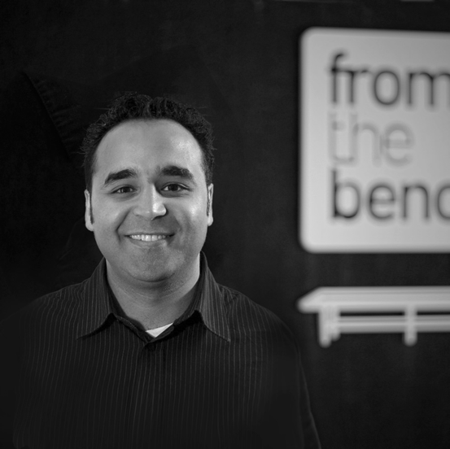
APPENDICE
MANAGEMENT
BUSINESS ANGEL
Lotfi El-Ghandouri
CREATIVE & HUMAN RESOURCE
Author of two books on audacity and engagement translated in 5 languages. Giving conferences on Creativity, engagement and audacity. Workshop host on: Collaborative Methodologies, Personal Risk and Uncertainty, creativity, social innovation, diversity, inner strength, and team cohesion. Speaker in different international forum.
Academic background
Master in International Marketing, ESCEM France.
Bachelor in HR, Sherbrooke University Canada.
Achievements
Associate professor at Oxford University and IE Business School.
WInner of Speaker of the year in Austria.
Languages
French, English, Spanish, Arabic.

Slide 59
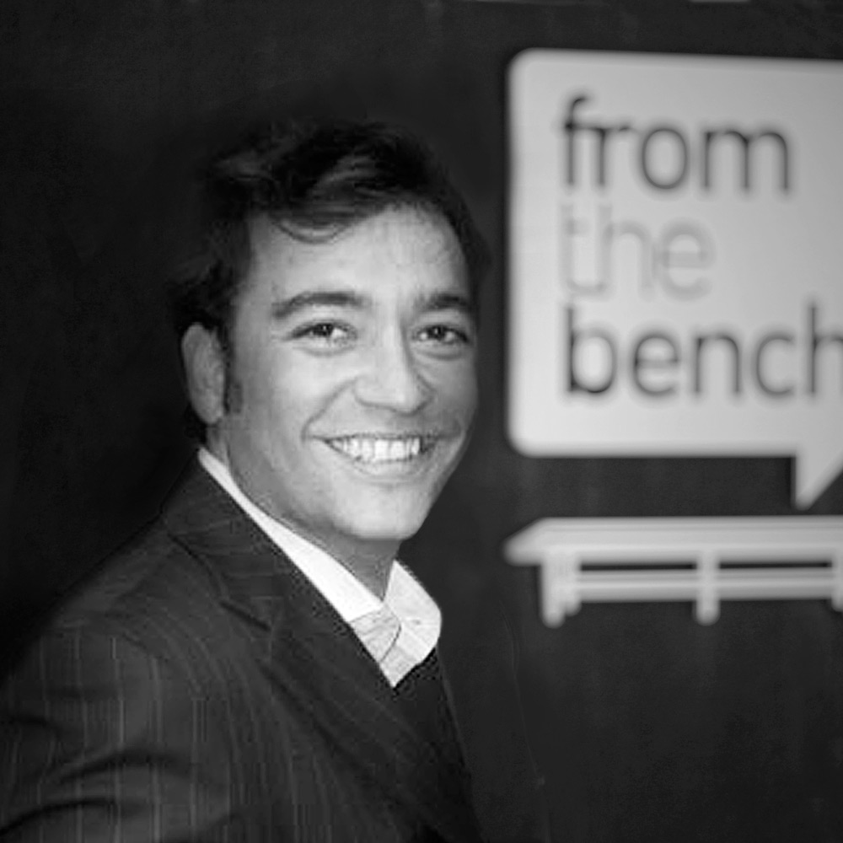
APPENDICE
MANAGEMENT
BUSINESS ANGEL
José Almansa
DISRUPTIVE ENTREPRENEUR
Wide experience as entrepreneur. We has founded more than 22 companies, 15 of them are still operating.
Some of these companies are HUB Madrid, West Global Technologies, Nisu Automotive, Ride Runner or Serendipity Story.
Exper.
Entrepreneurship Tutor, IE Business School. Madrid.
Academic background
MBA from IE Business School. Madrid.
Degree in Law. University of Madrid.
Languages
Spanish (mother tongue), English (fluent), French (advanced) and Italian (advanced).

Slide 60
サンキュー！

